Slide 1
Patient Privacy as Ethical Dilemma in Nursing
Name
Date

Slide 2
Introduction
Ethics in Nursing
The issues happen choices need to be made in regard to contradicting concepts. There is always a choice to be made.
The issues to be chosen revolve about ethics and any choice has either positive or negative consequence in equal measure. The answer may not be clear while the options are not ideal.
In the nursing profession, the results could decline the quality in the healthcare provision. Additionally, there could be rise in healthcare problematic issues as well as moral distress (McDermott-Levy, Leffers, & Mayaka, 2018).
In short, the ethical dilemma is about the knowing the right vacation to take in a prevailing scenario but the action may bring about certain consequences that one may be held accountable of at the end.
The nurses have these issues because their roles involve mentorship, counselling and even leadership roles. There is need for ethical decision making for the nurses while in their daily operations.

Slide 3

Ethical Dilemma in Nursing
Ethical dilemma involves the issues to be chosen revolve about ethics and any choice has either positive or negative consequence in equal measure.

Slide 4
Patient privacy
Definition of Patient Privacy
Evolutional Development of Privacy
Issues of Patient Privacy
Notes:
Definition of Patient Privacy
According to the Health Insurance Portability and Accountability Act the Privacy Rule is about the protective measures in matters health information which is acquired for scientific application and uses.
Evolutional Development of Privacy
Throughout the medical and healthcare field, the privacy and confidentiality on information have been a key pillar in the ethical practices.
The aspects have been there since the era of classical antiquity even though they might have been expressed differently. The definition of privacy continues to be expanded from the olden has to the recent times. In he past the confidentiality was defined as the secrets of an individual. The origin was from the Attorney General Sir Edward from England who stated that an individual has the right to privacy in their house. As the lives of humans get more complex, the concept of privacy has continued to evolve and get complex too. The definition has been explained differently such as the control over oneself, solitude, anonymity among others. Today the definition has advanced to the freedom to have control over ones personal information. The information revolves about ones affairs such as the possessions, conducts and communication (Kayaalp, 2018).
Issues of Patient Privacy
Protecting the privacy of patients’ is an aspect that calls for support from all the health stakeholders. Each member of the stakeholders has a role to play in generation in ensuring privacy of the patient’s information and affairs. Institutions should be the ones responsible for the selection of the appropriate tools and in monitoring for the same tools for adequacy and also ensure that before any data is delivered to the user, there is appropriate de-identification.
Patient privacy should also be considered at all levels of the treatment or handling the patient by the various stakeholders. The privacy involves the results of the diagnosis, the personal details given out during the process of treatment among other details.

Slide 5
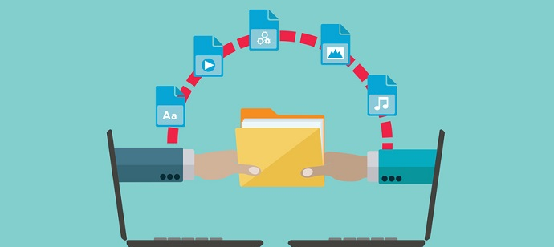
Patient Data Privacy
Patient data privacy is a significant element in the growth of healthcare sector since it aids growth of integrity in the healthcare sector and the industries involved.

Slide 6
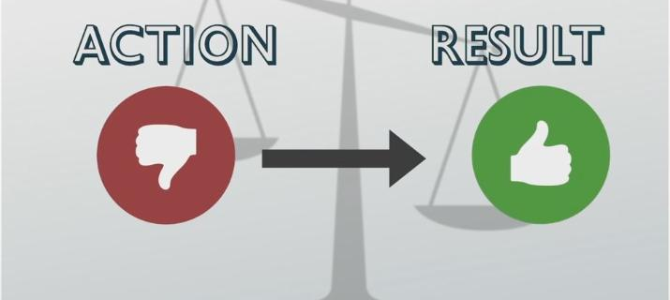
Data Privacy Methods
To ensure data privacy and safety Action must be taken to get Results

Slide 7
Utilitarian Argument of Patient’s Privacy
Confidentiality is an ethical practice and an obligation in medical practice.
Patients need guarantee ion the confidentiality of their information.
Lack of guarantee of confidentiality may bring about misdiagnosis.
Utilitarian view is about the calculation of the effects of disclosing information or confidentiality in regard to future patients.
Notes:
In medical practices, privacy and confidentiality when it comes to the information of the patients. The concept is not just a practice but an ethical obligation that the practitioners must uphold at all times of their profession. Breach of confidentiality can only be allowed at particular unavoidable circumstances with the aim of protecting party from any form of harm.
The discussion on the privacy mostly involves a utilitarian approach of viewing things. In this approach, the patients are to be guaranteed of confidentiality if they are to openly speak out to doctors and other medical practitioners. The information that the patients give out is relevant in providing the best healthcare services by the doctors and the nurses. The patient may therefore be forced to give out information that according to them is confidential and they wouldn’t have wished to share it out to the public. Therefore failure to trust the confidentiality of the doctors with the patient information may lead to concealing of some information by the patient due to fear (Mandal, Ponnambath, & Parija, 2016). The improper presentation of information by the patients may cause the doctors to carry out improper diagnosis on the patients. Improper diagnosis means wrong treatments hence hazard to the health standards of the involved party (Jones, 2003). . In other instances there may be lack of treatments since the patient may fail to attend for any diagnosis.
The utilitarian view of the concepts argues on the effects that the confidentiality or disclosing information may have on the potential patients who require diagnosis. The approach brings about a calculation on the effects of the disclosure or the confidentiality. The calculation involves the behavior of the patients when exposed to various levels of confidentiality (Kayaap, 2018). There is a probability that the patients will be reluctant to speak out to give out a piece of information when there is anticipation of disclosure. Therefore the justification of the utilitarian view will be proved by such scenarios.

Slide 8
Keeping Information Private
There are different ways that information can be secured against disclosure.
The methods of security are either technical, administrative or physical safeguards.
Apart from the privacy and security, the methods also ensure information integrity is observed and maintained.
Through the safeguards, the healthcare providers can access the information for the care to the patients.
Notes:
Physical safeguards include:
Using encryption in the devices of information
Carrying out data backup or preservation of copies
Proper disposal of outdated and unusable devices
Emergency contingency maintenance of protocols
Restriction of physical access of information for unauthorized persons

Slide 9
Keeping Information Private
Technical and Administrative Safeguards
The technical measures involve:
  the measure that requires a technical expert to install software.
  IT related concepts in order to secure data in electronic form.
Administrative methods can be as follows:
  Office-related operations
  Documents keeping and records keeping
  Management involvement
Notes:
The technical measures include the use of firewalls which prevent hacking of data. The use of use of transmission modes such as VPN and SSL and other encryption techniques.
Administrative methods can be as follows:
Staff training on data security matters
Documenting security policies of various departments
Enforcement of policies involving data storage and backup electronically
Documentation of matters relating to the policies and procures such as the disciplinary actions.
Provision of methods to solve the security issues as well as reporting of such incidents.
Conducting of auditing of all the systems through user identification.

Slide 10

Data Security Training
Staff Training on data security is an administrative safeguard on the keeping data private.

Slide 11
Importance of Patient Privacy
High quality of data
  Proper validation and verification through access by patients.
Boosts Doctor-Patient Relationship
  Trust about confidentiality
Notes:
High Quality Data
The quality of any data in the healthcare system is dependent on the frankness of the patients as they give their information. In this era of digital data, there is the ability to process large amounts of data in less time. The accuracy of the data can be confirmed by allowing the patients have access to their personal information in order to verify it. From such processes, the data is readily available for making conclusions and medical inferences for better healthcare (Schieke, 2018).
Boosting of doctor-patient relationship
Doctors-patients relationship is boosted through privacy. In an environment that aims at dynamic in the patients-doctor relationship, privacy is key. In order for any healthcare system to manage and sustain trust between healthcare professionals and patients, one of the factors is to ensure privacy is enhanced. If patients suspect or perceive that doctors may use their personal information of rother use outside the normal diagnosis, they may withdraw from giving out their information. The healthcare system will be affected since the doctors depend on information to carry out diagnosis of diseases and offer health solutions. If there is trust by the patients that the information wont be used to their disadvantage, they freely give out information to the doctors and be keen on the doctors view about their health. Therefore a relationship is created.

Slide 12
Privacy Pros
Fairness and Balance
  Prevention of sale of information to some companies
Patient’s Assurance of access to data
  The access gives patients freedom to choose the healthcare system such as insurance
Notes:
Fairness and balance
There are companies that have made profits from the use of personal data. The companies have made customers as their commodity where they sell their personal informational to institutions in order to earn through them. The process is unfair and unethical since the data has been used in ambiguous ways and in manipulation of economy by favoring only few entities. Therefore, there is unfairness in the business deals where there are organizations that gain competitive advantage through unfair means. The health records give way for institutions like insurance companies, financial institutions, pharmaceuticals among others. Therefore, the privacy will enhance balance in the economy by ensuring here is fairness in the business dealings.
Assurance of access to data
There is always a need for patients to have access to their information in the healthcare system records. The access gives them the clarity about their health conditions. In that regard the patients can learn how to work out their health practices. Additionally, they will have the freedom to make their choices on the healthcare systems that they would desire. For instance, they would make choices on the best insurance company they can consult for their health cover. The patients could also have the freedom to allow the researchers I the medical filed use their data for research purpose only hance making contribution to the research sector for sustainability.

Slide 13

Patients’ data Privacy is critical
Data Privacy is important to the patients and the doctor who is carrying out the medication.

Slide 14
Disadvantages of Patient Privacy
Medical care administrative requirements
  Requirements on professionals increased
Payment of fines
  Heavy fines regardless of the business size
Change of information dissemination
  Results are picked by patients to avoid violations of privacy
Notes:
Increment of medical care administrative requirements
The law allowed access of personal information by the patients. The step led to the increment of coverage possibilities in the change of positions. Through this, there was creation of administrative headache for the professionals in the healthcare sector where the legislation was actively in work during the initiation stages. Accomplishment of compliance spent a lot funds get the best results (Gaille, 2018).
Payment of fines by Service Providers in violation
There are high levels of fines that must be paid by anyone who violates the legislations. Slight breaches of data attract fines which must be paid regardless of the size of the businesses.
Change of information dissemination
The release of information to patients changed. The action was boosted by the severity of the fines upon violation of the regulations. The medical professionals became more cautious about the medical results discussions by the patients. The medical professionals have changed to an extent where they have requirements where only the patients can pick the results in person.

Slide 15
Significance of Protective Measures
Maintenance of Efficiency
Data Breach is Expensive
Healthy for Patients
Notes:
Efficiency Maintenance
When the patient data is kept private, there is guarantee of continuous efficiency. Any breach in the data safety and privacy may call for the health institutions and organizations to switch to paperwork in data keeping and filing as they wait to retrieve the electronic data. Efficiency may be lowered hance the need to observe the privacy at all times. Keeping up with the population growth while using paperwork as the methods of keeping records may slow down operations.
Data Breach is Expensive
Breach of data safety can be very costly for any organization since the healthcare information is very critical. In case of a breach an organization may be forced to pay heavily for lawsuits. The rate of growth of the healthcare data is growing at a higher rate as compered to other sectors such as the manufacturing, media, finance among others (Gaille, 2018).
Healthy for Patients
The information on health of a particular patient is significant not only to the healthcare organization but most important to the individual. The patient may wish to preserve the information on their health conditions. The information is important to the patient and the doctor only and nit to be disclosed to a third party.

Slide 16
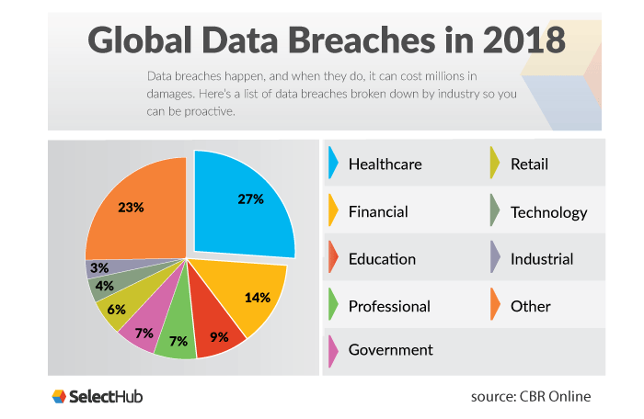
Data breach is expensive

Slide 17

Conflict Management
When there is conflict in regard to patient privacy, solution should be established to avoid future similar conflicts.

Slide 18
Solution to Conflicts
Conflict management can be carried out in various ways using different strategies. In order to preserve quality relationship and avoid more conflicts in the data privacy in healthcare sectors, there is need for resolution of conflicts while involving the parties at conflict.
Conflict resolution involves creativity and skills of solving problems. In data privacy when there is breach, trust is broken. In order to mend the trust, there should be a guarantee to safeguard the breach of data (Grubaugh, & Flynn,2018).
For instance, in case the patient has a conflict with the healthcare professional or organization in regard to loss or disclosure of information, the solution to the conflict should be safety keeping of the data and rectifying the mistake that led to disclosure.

Slide 19
References
Kayaalp, M. (2018). Patient privacy in the era of big data. Balkan medical journal, 35(1), 8.
Woogara, J. (2005). Patients’ privacy of the person and human rights. Nursing ethics, 12(3), 273-287.
Zhang, H., Zhang, H., Zhang, Z., & Wang, Y. (2021). Patient privacy and autonomy: a comparative analysis of cases of ethical dilemmas in China and the United States. BMC Medical Ethics, 22(1), 1-8.
Rainer, J., Schneider, J. K., & Lorenz, R. A. (2018). Ethical dilemmas in nursing: An integrative review. Journal of clinical nursing, 27(19-20), 3446-3461.
Mandal, J., Ponnambath, D. K., & Parija, S. C. (2016). Utilitarian and deontological ethics in medicine. Tropical parasitology, 6(1), 5.
Jones, C. (2003). The utilitarian argument for medical confidentiality: a pilot study of patients’ views. Journal of medical ethics, 29(6), 348-352.

Slide 20
References
Grubaugh, M. L., & Flynn, L. (2018). Relationships among nurse manager leadership skills, conflict management, and unit teamwork. JONA: The Journal of Nursing Administration, 48(7/8), 383-388.
Schieke, M. (2018, June 19). Five reasons patient data privacy is so important. Connected World. https://connectedworld.com/five-reasons-why-patient-data-privacy-and-control-is-so-important/
McDermott-Levy, R., Leffers, J., & Mayaka, J. (2018). Ethical principles and guidelines of global health nursing practice. Nursing outlook, 66(5), 473-481.
Gaille, L. (2018, December 21). 22 pros and cons of HIPAA. Vittana.org. https://vittana.org/22-pros-and-cons-of-hipaa

